Slide 1
Umbraco on Docker
From Zero to a Container App - a Step by Step Guide
https://github.com/CarlSargunar/Umbraco-Docker-Workshop

Slide 2







Carl Sargunar
Poornima Nayar
@CarlCod_es
https://carlcod.es
Likes Raspberry Pis & IoT Stuff
Also Umbraco and Docker
@PoornimaNayar
https://poornimanayar.co.uk/
Microsoft and Umbraco MVP

Slide 3
What is Docker?
Docker is a set of platform-as-a-service products that use OS-level virtualization to deliver software in packages called containers.
Containers are isolated from one another and bundle their own software, libraries and configuration files; they can communicate with each other through well-defined channels.
Little virtual machines?
...Ish (but not really)
Notes:
Virtualization : creating a virtual version of computer hardware, storage devices, and network resources to host guest operating systems.
Uses HyperVisor (typically in hardware)
Docker - works on top of host operating system
Manages host resources directly and passes through to containers where required
This Abstraction is why you can’t have different operating systems

Slide 4
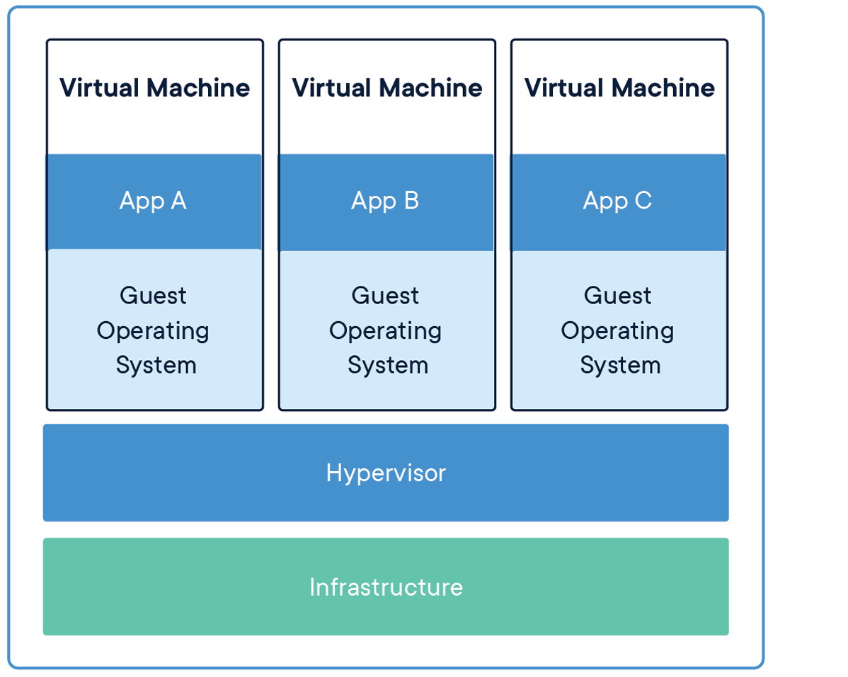
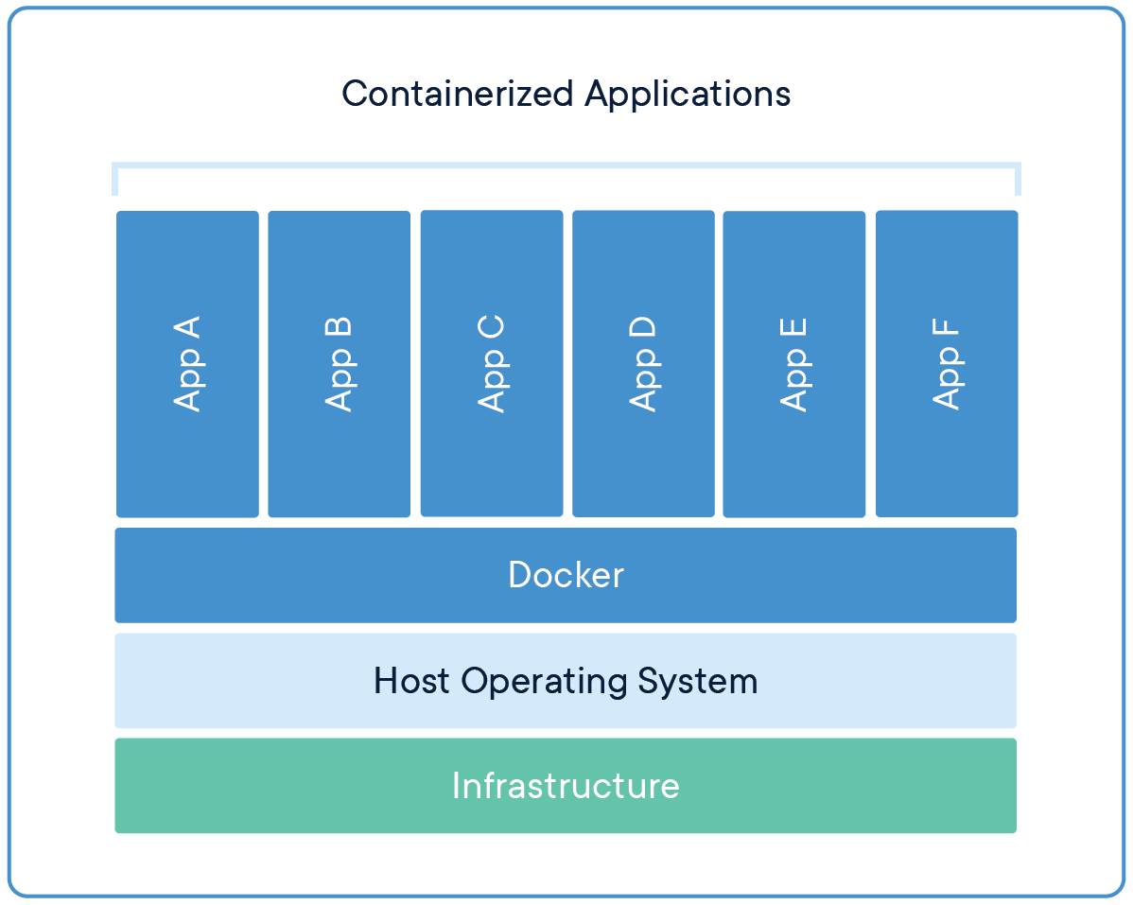
Virtual Machine vs Docker
Virtual machines virtualize the hardware. Docker virtualizes the operating system
Notes:
Virtualization : creating a virtual version of computer hardware, storage devices, and network resources to host guest operating systems.
Uses HyperVisor (typically in hardware)
Docker - works on top of host operating system
Manages host resources directly and passes through to containers where required
This Abstraction is why you can’t have different operating systems
You CANNOT run windows containers on Linux
BUT you CAN run Linux containers on Windows using the windows subsystem for Linux
You definitely want to run Linux containers because they’re a LOT smaller than windows containers
NanoServer has brought the size of windows container sizes down MUCH smaller (approx 6-800 MB) and closer in performance

Slide 5
What is a container?
Container
Host Server
Docker Infrastructure
Application
Networking
Networking
Networking
Container Storage
Persisted Storage
Additional Storage
Additional Storage
Notes:
Container :
Image :

Slide 6
Monolithic Architecture
User Interface
Tightly Coupled
Deployed at once
Resistant to big changes
Complex codebase for large applications
Can be harder to Test
Harder to scale (Tech & Cost)
Harder to Onboard new team members
New technology barriers
Nothing wrong with it!
Back End
API
Business Logic
Data
Index
Notes:
Cross-cutting concerns - affect the whole application
logging,
handling caching,
performance monitoring.
In a monolithic application, this area of functionality concerns only one application so it is easier to handle it.

Slide 7
Micro Architecture
Container
Independently deployable pieces
Works well with Single Responsibility Principle *
Loosely Coupled components
Independently testable
Not restricted to using the same tech stack
Repeatable
Small easily manageable codebase per unit *
More complex overall
NOT better, just different strengths and weaknesses
Application
Networking
Container Storage
Persisted Storage
Notes:
Application is broken into smaller pieces - the size is dependant on what you need
Single Responsibility is really important! Not just with docker but with software generally.
Clean code
Easily Testable
Self documenting
Loosely coupled => Can swap out services for different implementations

Slide 8
Container Volumes and Persistence
Container
Storage volumes are defined when the container is created
Can be physical storage or NAS
Attaching volumes allows recovery and resumption - critical for data stores
Can be shared between containers for configuration or lookup information
Volumes can be moved to different hosts
Application
Container Storage
Host
Host Storage
Notes:
Shared between containers : So you can share
Data sources (eg Json files)
Configuration information : Shared secrets, configuration etc
Moved between hosts : For upgrades, or through managed services

Slide 9
Networking in Docker
Container A
Container C
Application
Application
Container D
Application
Container B
Data Store
Bridge Network : Default is for all, but can be isolated
Host - Uses the docker host network
Other advanced types inc Overlay, Macvlan, IPvlan
Notes:
Bridge : Default. Bridge networks are usually used when your applications run in standalone containers that need to communicate
Default - All containers can see all other containers
But containers can ONLY access each other by IP address!
User Defined (Diagram)
Host : Use the host machine networking directly. Only works on Linux, not Docker Desktop for windows or mac
Overlay : multi-host network communication - between hosts
Others :
Macvlan
IPvlan

Slide 10
Communication in Docker
Direct Network
Message Queues
Container A
Container B
A
B
B1
File Sharing
A
B2
Container A
Container B
B1
A
Storage
B2
Notes:
Published Ports
Ports need to be Exposed before they can be accessed
Will depend on the network mode your container is running in
File Sharing
Use shared volumes - read and write from files
Be considerate of file locking
Message queues
Fifo basic queues
Work Queues (Fifo with many workers)
Publish Subscribe : sending messages to many workers at once,
Many design patterns and whole talks have been dedicated to this

Slide 11
A few Docker Concepts ...
DockerFile
A YAML file - contains all the commands a user could call on the command line to assemble an image
Defines your base Images - the building blocks of your application.
Docker Compose
A CLI tool which lets you define an application made up of a collection of containers
Used to create related images which can be deployed together
Docker Ignore file
Define the files you don’t want included in your image. Eg build artifacts
Notes:
Dockerfile
Name
Base image
Ports
Volumes
Docker Compose
Define your app environment - so it can be used anywhere, and each time is repeatable
Define the services which make up your app -> Run in isolation
Dependencies between these services

Slide 12
The Plan
Development
Staging
Production
Website
Website
Website
Website
Website
Website
Website
Database
Database
Database

Slide 13

Blazor

Slide 14
What is Blazor?
Build rich, interactive, client-side UI with .NET
Run C# on the browser without code transpilation
Leverage the .NET ecosystem of libraries and benefit from the performance and reliability and security
Supported on all modern web and mobile browsers
JavaScript interoperability
Build hybrid desktop and mobile apps

Slide 15
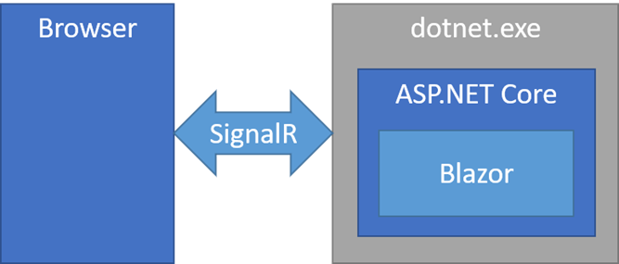
Blazor Server
Released in Sept 2019, alongside .NET Core 3.0
Host Razor Components on the server in an ASP.NET Core app
App is executed on the server
UI updates, event handling and JavaScript calls are handled over a SignalR connection
Requires an active SignalR connection

Slide 16
Blazor Server Prerendering
Razor components compiled to static HTML and sent to client upon first request
When SignalR connection is established, the static elements are replaced with interactive elements
More responsive app

Slide 17
Blazor Server UI Updates
Component graph re-rendered
UI difference calculated and sent to client
Applied by browser

Slide 18
Blazor WASM
Principal hosting model
Released in May 2020
Run .NET code in the browser using the JavaScript security sandbox
Assemblies are downloaded to the client and runs from the client
DOM manipulation using JavaScript interop
PWA
Pre-rendering functionality using hosted app

Slide 19
Blazor Hybrid
Extension to Blazor
Build native desktop and mobile apps using Blazor and .NET MAUI
Use embedded web view control to render Web UI
No browser, no HTTP, native app running on the device
Best of both worlds - broad reach with web and access native device capabilities
Use web development skills to build native apps
Enables embedding Blazor functionality
Bring Razor Component Libraries into native devices
Uses WebView2

Slide 20
Razor Components
Building blocks of Blazor apps
Razor markup with a .razor extension. Formally called Razor Components
Can be a page, a form or a dialog
Component names must always start with an uppercase character Mycomponent.razor
Include a component in a page or another component by using the name of the component as a HTML tag. For e.g. a component called Mycomponent.razor can be called as
< Mycomponent ></ Mycomponent >
Ability to nest components, can be reused or even shared among projects

Slide 21

Umbraco Headless(-ly)

Slide 22

Umbraco Heartcore

Slide 23
Component Lifecycle
SetParametersAsync
OnInitialized{Async}
OnParametersSet{Async}
OnAfterRender{Async}
Set parameters for the component
Init the component
After component init and then everytime after a parameter value changes
Set parameters for the component

Slide 24
o o
Thank you

